Slide 1

Department of Computer Science and Engineering
Technical seminar Report on
Microsoft Xbox One& Kinect
Done by :
A.S.S.BHARADWAZA (11T81A0525)
UNDER THE GUIDANCE OF
Mr.V.RAMAKRISHNA, HOD CSE Dept.

Slide 2


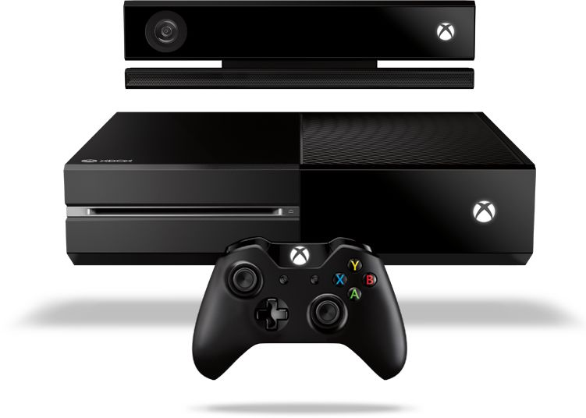

Slide 3

CONTENTS:
INSIGHT ON XBOX ONE
KINECT
  INTRODUCTION TO KINECT
  HARDWARE
  KINECT ANATOMY
  KINECT AUDIO
  WHAT KINECT DOES?
  SKELETON DATA
  KINECT SENSOR DATA
  KINECT APPLICATIONS
  WHY KINECT IS REVOLUTIONARY?
  CONCLUSION
  BIBLIOGRAPHY

Slide 4
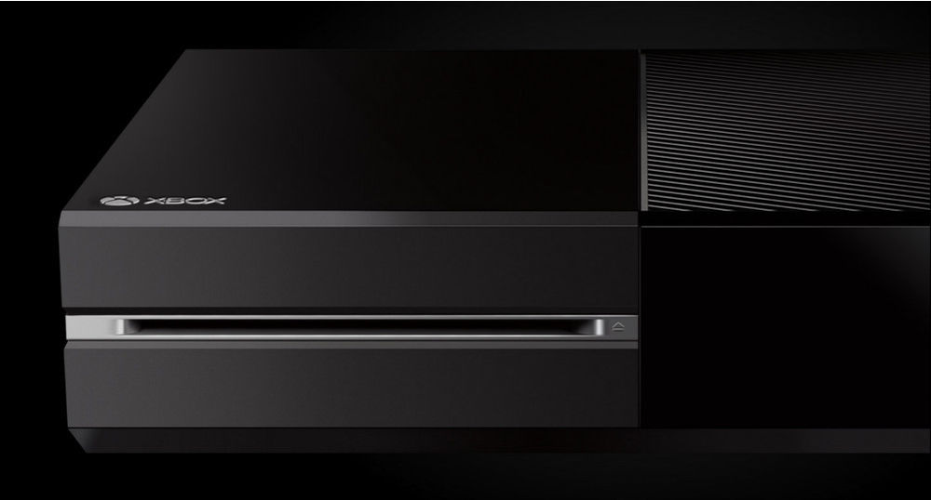
INSIGHT ON XBOX ONE
Microsoft Xbox One takes you to a new generation filled with entertainment and new games.
The new Microsoft Xbox One has been designed in a way that it will be the most advanced and entertaining gaming console ever.
This gaming console has for the fist time developed a gaming OS that has been amalgamated with the super powerful Windows OS.
It is also powered with the 8-core x86 processor that allows you to shift instantly between the game and the apps.

Slide 5
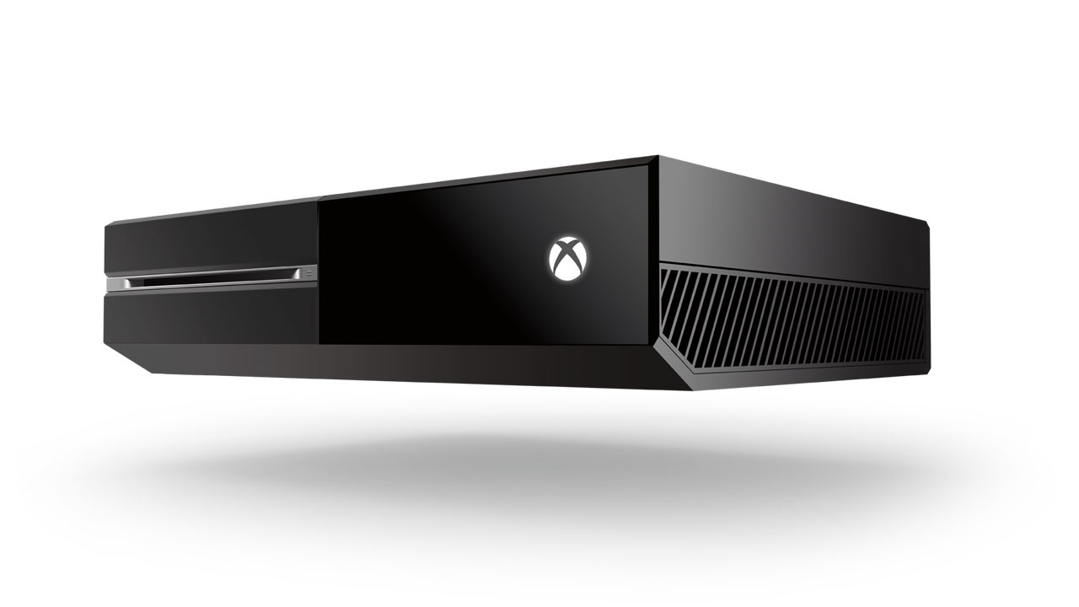
Microsoft Xbox One is always ready. It wakes up instantly when you want to play. This means less waiting time and more gaming time.
Split Your Screen and not your Time!
With Snap enabled in the console you can chat with friends and play games at the same time. You just need to split your screen and you go do both on the same screen.

Slide 6
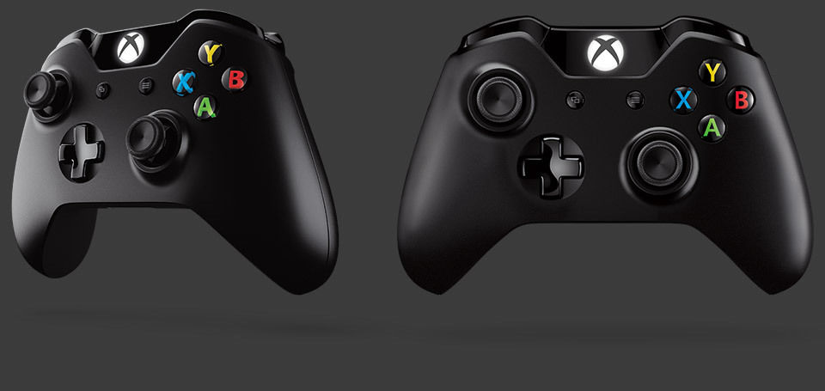
The latest and new Impulsive Xbox One's Controller.
Microsoft has much efficient thumbsticks-pad and contours that give you an improved precision and comfort.

Slide 7
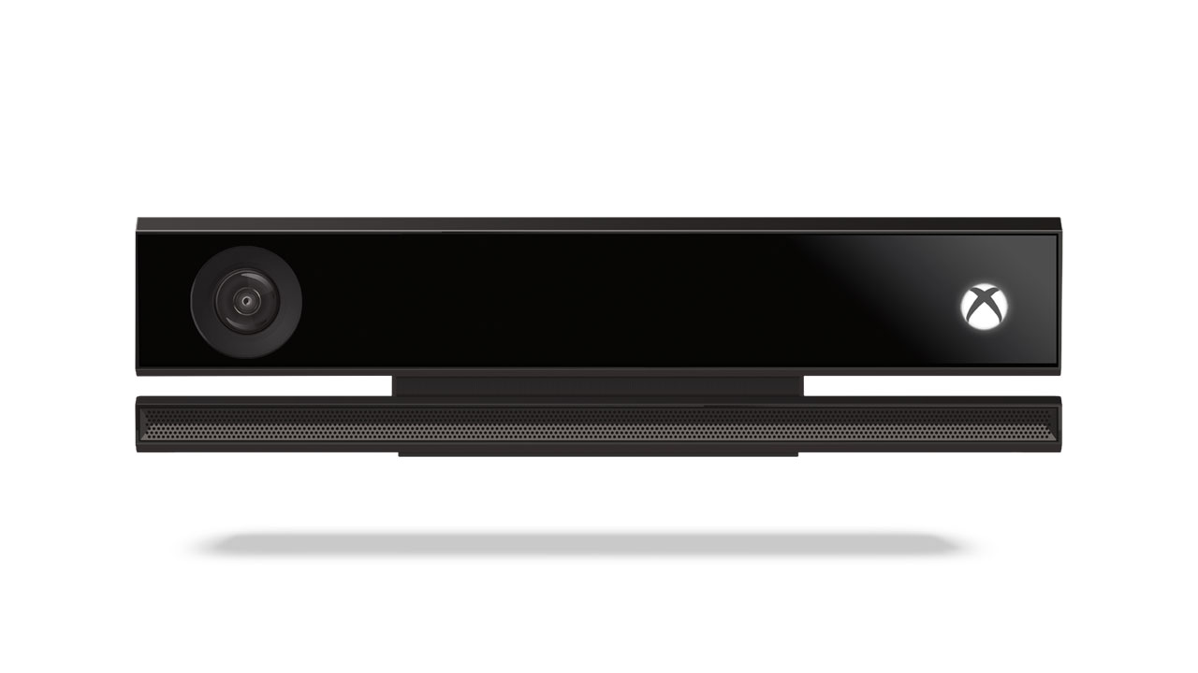
The new and unparalleled voice, motion and vision technology gives you a new experience while gaming like never before.
It allows you to sign in automatically when you enter the room and speed up in the game with simple gestures.
You can also navigate your favorite TV Show with your voice.
It includes a 1080p, HD camera. All-new, active-infrared capabilities increase precision, allowing it to work in nearly any lighting condition and expanding field of view to accommodate a greater variety of room sizes.
Microsoft proprietary Time-of-Flight technology measures the time it takes individual photons to rebound off you to create unprecedented accuracy and precision.

Slide 8
INTRODUCTION TO KINECT
Kinect (portmanteau of kinetic and connect), originally known by the code name Project Natal, is a motion sensing input device by Microsoft for the Xbox 360 video game console.
The technology behind Kinect was invented in 2005 by Zeev Zalevsky, Alexander Shpunt, Aviad Maizels, Javier Garcia and Alex Kipman headed the Kinect project for Microsoft.
Kinect launched for the Xbox 360 in the year 2010.
Kinect builds on software technology developed internally by Rare, a subsidiary of Microsoft Game Studios owned by Microsoft .
It is based on the Range camera technology by Israeli developer PrimeSense.

Slide 9
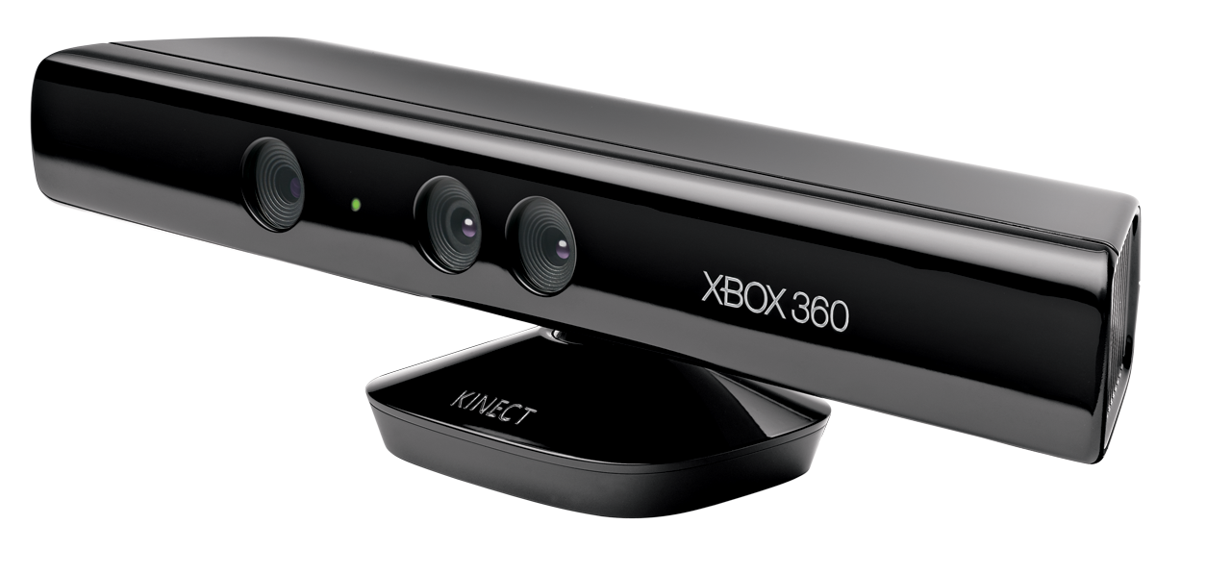
Kinect Hardware
3D DEPTH SENSORS
RGB CAMERA
MULTI-ARRAY MIC
MOTORIZED TILT

Slide 10
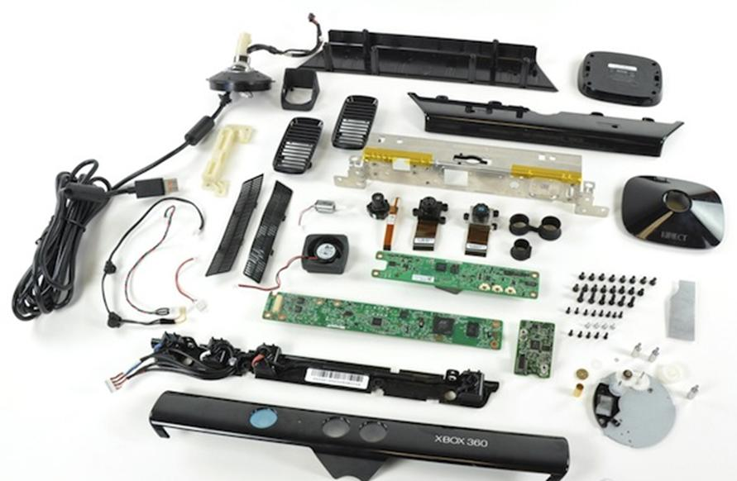
WHAT IS INSIDE KINECT ?

Slide 11
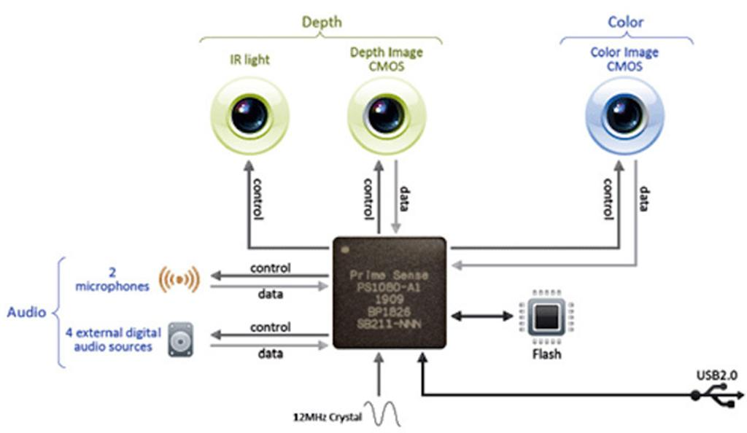
KINECT ANATOMY
Kinect has FOUR microphones to retrieve spatial sound and attenuate noise,interferences and compensate for room acoustics.
However PrimeSense states that it can see but not process as players as many people as present in the field-of-view of the camera.

Slide 12
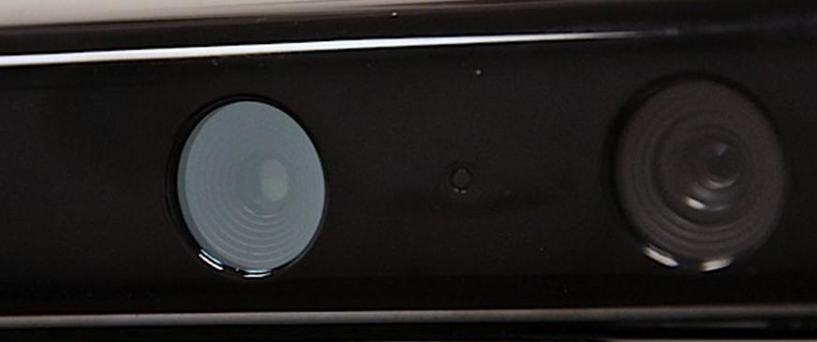
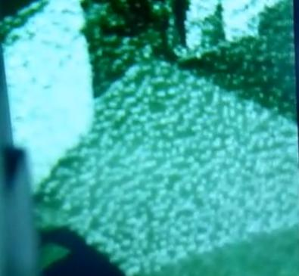
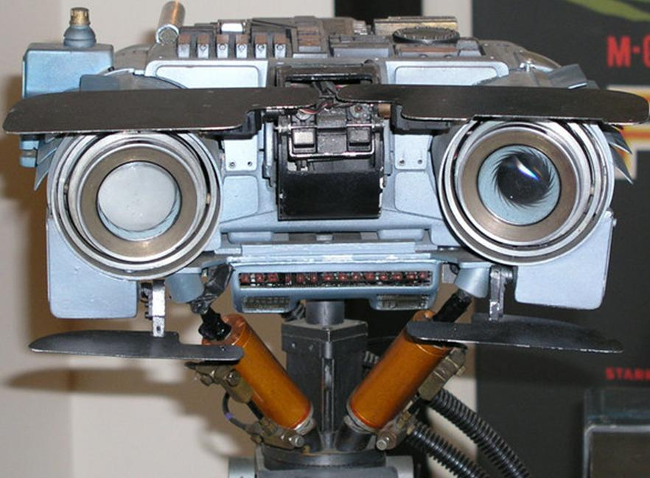
MOST ADVANCED ASPECT
Eyes of Kinect are made by an INFRARED MEASUREMENT SYSTEM-Laser beam is send from the objective and received by sensor as can be seen above.
These sensors can move to adjust for the distance and height. This device produces MAP OF DEPTH to objects in a room.

Slide 13
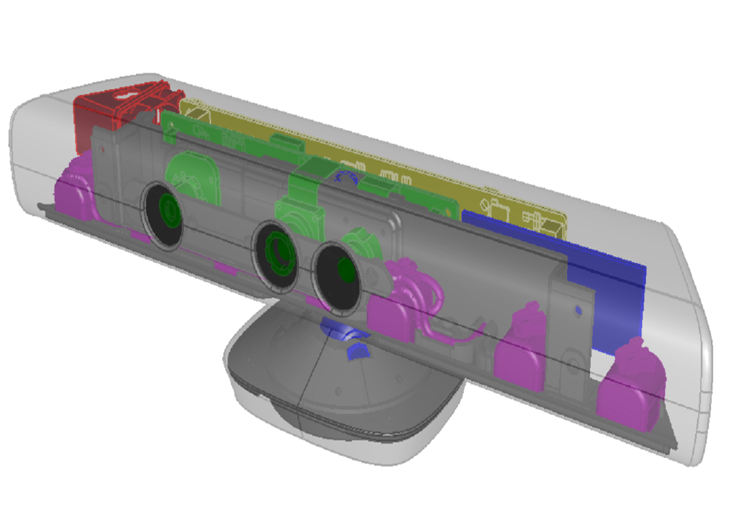
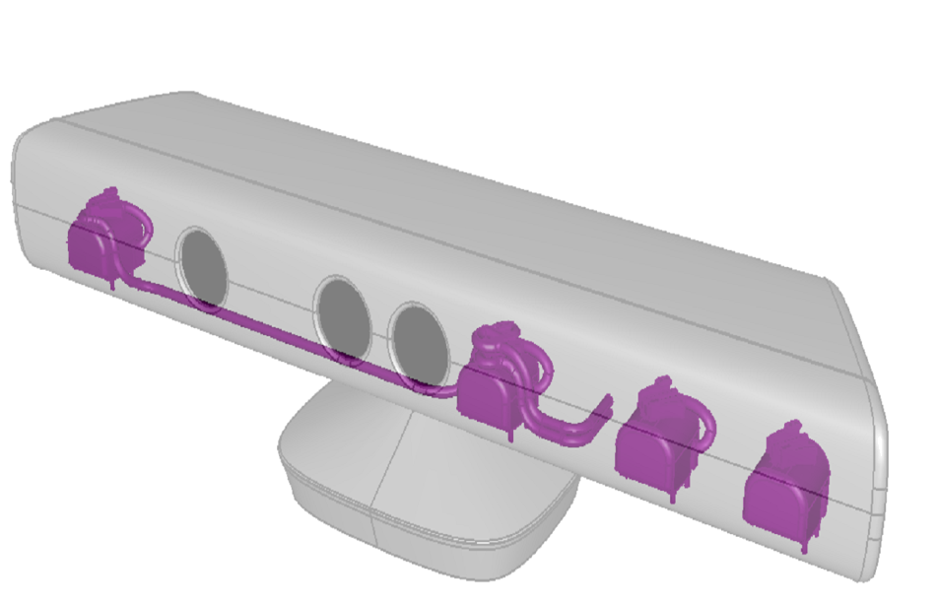
KINECT AUDIO
  Four microphone array with hardware-based audio processing
  Multichannel Echo Cancellation (MEC) & Sound position tracking
  Kinect sensor's microphone array enables the Xbox to conduct acoustic source localization and ambient noise suppression, allowing for things such as headset-free party chat over Xbox Live.

Slide 14
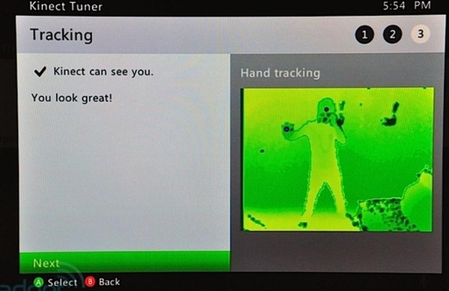
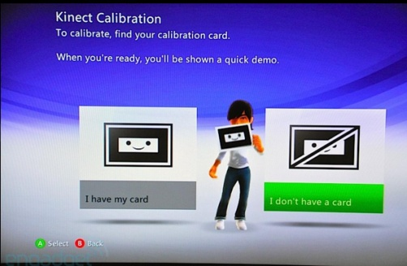
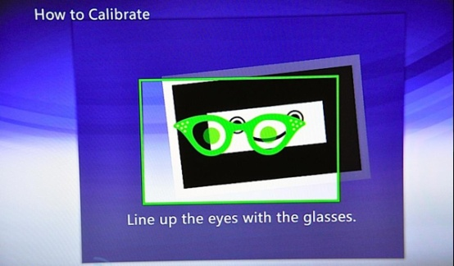
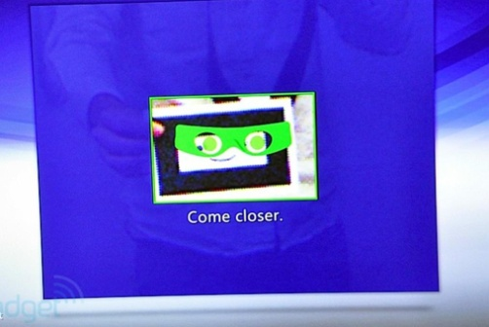
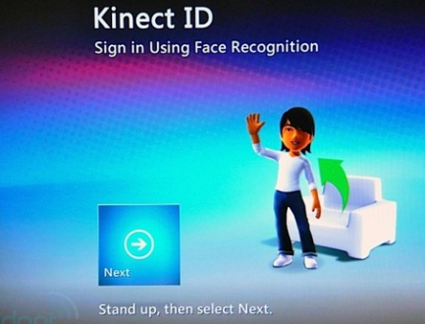
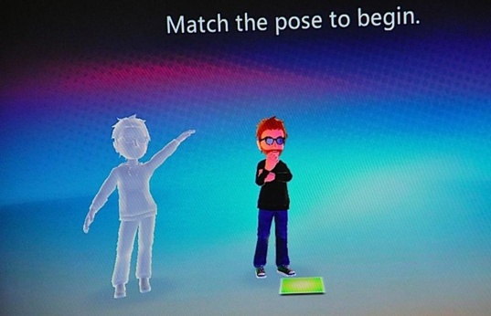
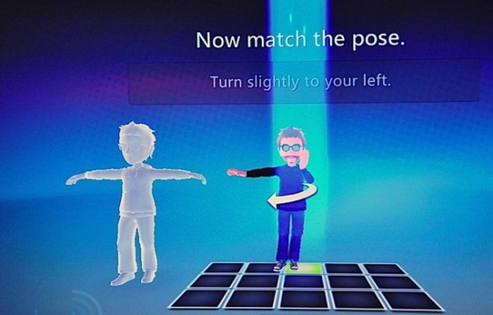
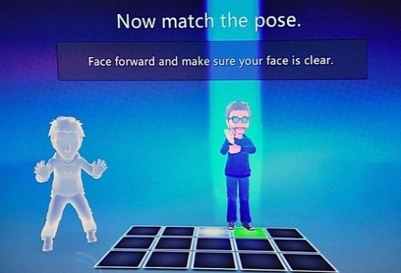
WHAT KINECT DOES?
Kinect recognizes voice IN ROOMS and can be used for voice control of applications.
Kinect recognizes persons and body movements which is used in applications.
But before this Kinect is TRAINED interactively like shown in pictures.
After the training person and body movements will be recognized.
More than one person can be identified in a scene

Slide 15
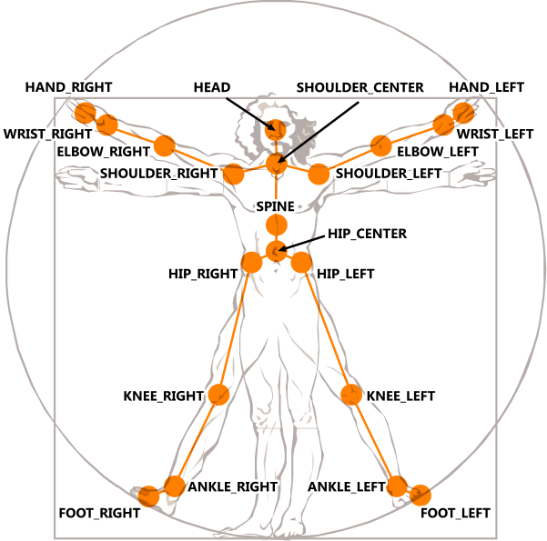
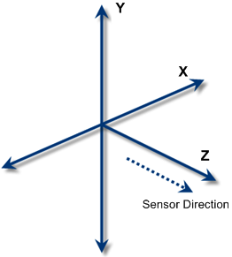
SKELETON DATA

Slide 16

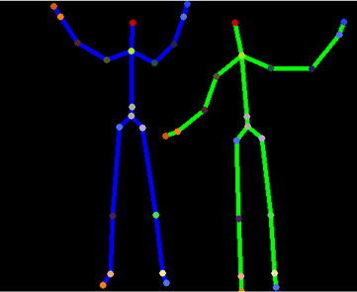

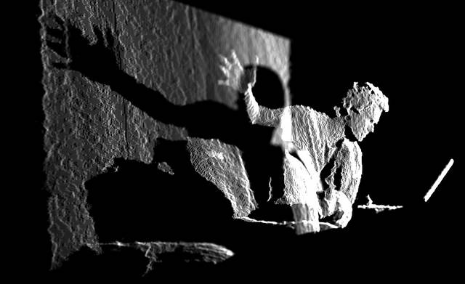
KINECT SENSOR DATA

Slide 17
WHY KINECT IS REVOLUTIONARY?
It is the first practical natural user interface for machines communicating with people
It is combining acoustical and visual sense
It is recognizing full body movements, even complicated ones
It finds application not only in games but also in the field of medical sciences and robotics.
After selling a total of 8 million units in its first 60 days, the Kinect holds the Guinness World Record of being the "fastest selling consumer electronics device".

Slide 18






KINECT APPLICATIONS
Games and interactive playing (sports, dancing, arcade, action, strategy)
More applications: exercising, rehbilitation, child development
Control of devices by voice, gestures
Automation and robotics
Medical Sciences

Slide 19
CONCLUSION
A new generation of games and entertainment.
Welcome to the all-in-one, Xbox One.
It's more fun on Xbox One
The most advanced multiplayer.
Breakthrough technology that keeps getting better.

Slide 20
Bibliography
How Microsoft Kinect Works:
  http://electronics.howstuffworks.com/microsoft-kinect2.htm
How Motion Detection Works in Xbox Kinect:
  http://www.wired.com/gadgetlab/2010/11/tonights-release-xbox-kinect-how-does-it-work/
Microsoft drops internal Natal chip:
  http://www.gamesindustry.biz/articles/microsoft-drops-internal-natal-chip_1
Kinect SDK Basics
  http://channel9.msdn.com/Series/KinectQuickstart/

Slide 21


Any Questions??

